Slide 1
Flipped classroom and PBL for active learning
Tore Nilsson, Department of language education

Slide 2
Active learning
”The outcome of learning depends on the characteristics of the student and on the nature of the task” (Entwistle, 2018)

Slide 3
Student approaches to learning
Deep
  Meaning: integrating the whole with its purpose
  Relationships: integrating the parts into a whole
  Personal experience: integrating the task with oneself

Slide 4
Student approaches to learning
Surface
  Unreflectiveness: treating task as something external
  Unrelatedness: treating task as an isolated phenomenon
  Memorization: treating the task as an exercise in memorization

Slide 5
The big question
”The outcome of learning depends on the characteristics of the student and on the nature of the task”
  If this is true – what can we do?
Can ”characteristics” be influenced?
Motivational processes: intrinsic vs extrinsic

Slide 6
Self determination theory
(Deci & Ryan, 1985)
A sense of competence
    autonomy
      relatedness
can direct students’ motivational process towards stronger intrinsic motivation

Slide 7
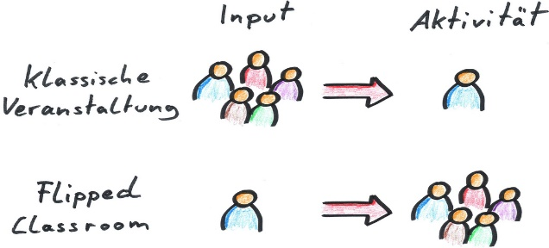
What and How: A short definition of Flipped Classroom
Recorded lectures are used for one-way transmission of course content
Quizzes check for basic retrieval and understanding
Teaching time is used for higher-order analyses and problem solving
flickr.com CC0 1.0
Notes:
https://www.flickr.com/photos/otacke/17038214737

Slide 8
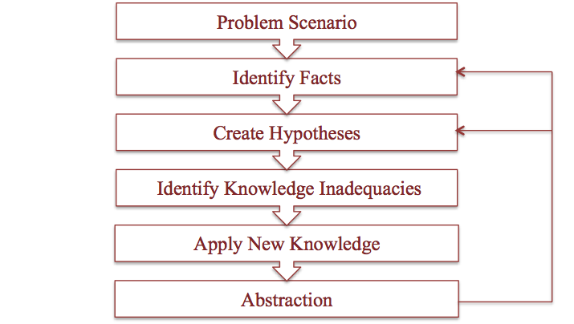
Problem-based learning process
Source: TeebaObaid (CC BY-SA 4.0)
Notes:
A more concrete model for collaborative learning is the problem-based learning process. PBL is an approach to learning that builds on a constructivist theory of learning where the interplay between individual and collaborative work is essential. For PBL to be really successful students need to be equipped with a certain level of basic knowledge which they bring to the problem scenario that is presented by the teacher. Students should familiarize themselves with the scenario first, and try to identify as many factual components as possible. They can do this on their own and write down their understanding of the scenario in such a way that it can be shared with other people in the group before they meet. At the group session students go through their different understandings of the scenario and at least three things should be established 1) a common ground 2) points of difference 3) knowledge gaps. When sufficient knowledge has been gained by the group as a whole and the individual group members you proceed to the next step, which is to suggest a solution to the problem scenario. Again this will involve deep discussions of all the key aspects of the scenario so as not to leave anything out and to present a unified and coherent solution that the whole group is satisfied with. If time permits a new round of dilemma discussions can be made by abracting further queries from the solutions. A whole class session rounds the topic off where all the groups present their understandings of the scenario and their solutions.

Slide 9
Asynchronous and individual work with course literaturand recorded lectures
Quizzes to check understanding of basic concepts
Synchronous and collaborative group work with more complex tasks
Whole class presentations of possible solutions
Individual assignment to check undertanding of complex conceptions of tasks, their solutions and a reflection on process and product
Creating
Analysing
Applying
Remembering
Evaluating
Understanding
Individual assessment
Whole class
Group
Individual
Notes:
So here I try to bring the strands together, and show how various instructional modes can be sequenced and how they gradually build deeper understanding. The model, as many models, is temptingly simple. Sometimes it can be necessary to loop the instructional sequences and do more than one round of basic knowledge work or to work through a scenario more than once, all depending on the course goals and the time at disposal. Furthermore, the model does not say anything about how long time can or should be spent for each sequence. One important thing, however, that I would like to point out here is that in order for higher-level cognitive work to take place successfully, the base must be really solid. This is probably one of the most important criticisms of constructivism – that students are left to tackle complex problems without have grasped the basics properly, and that generates frustration and demotivation on all parts. However, if it is carefully implemented and extended in time, I would argue that this model has many advantages.

Slide 10
Some key aspects
Frame and direction
Build a base – stress threshold concepts
Balance synchronous and asynchronous teaching activities
Product -> Process -> Product

Slide 11
Group task
Based on your own subject/discipline, identify one critical context where student engagement is a challenge for you
Suggest a way in which a learning sequence could be organized using asynchronous and synchronous activities in order to engage and challenge students.

Slide 12
References
Deci, & Ryan (1985).
Entwistle, N. (2018). Student Learning and Academic Understanding. London: Academic Press.

